Slide 1
Top 250 Ranked IMDB Movie Insights
Analysis conducted by Joshua Bransford
April 11th, 2024

Slide 2
Table of Contents
Scope and Data Setup
Scope
Data Setup and Cleaning
Analyzing Worldwide Earnings
Initial Insights
How Does Budget Affect Earnings?
How Does Genre Affect Earnings?
How Does Release Season Affect Earnings?
Analyzing Ratings
Initial Insights
How Does Budget Affect Ratings?
How Does Genre Affect Ratings?
Conclusions
Analysis Findings
What Further Analysis Can be Conducted?

Slide 3
Section 1: Scope and Data Setup

Slide 4
1.1 Scope
Movies Names | Rating out of 10 | Count of Ratings | Release Date | Budget | Domestic Gross
The Shawshank Redemption | 9.3 | 2.9M | October 14, 1994 (India) | $25,000,000 (estimated) | US & Canada
The Godfather | 9.2 | 2M | 1978 (India) | $6,000,000 (estimated) | US & Canada
The Dark Knight | 9.0 | 2.9M | July 18, 2008 (India) | $185,000,000 (estimated) | US & Canada
The Godfather: Part II | 9.0 | 1.4M | 1979 (India) | $13,000,000 (estimated) | US & Canada
12 Angry Men | 9.0 | 861K | April 10, 1957 (United States) | $350,000 (estimated) | US & Canada
Schindler's List | 9.0 | 1.4M | December 15, 1993 (India) | $22,000,000 (estimated) | US & Canada
The Lord of the Rings: The Return of the King | 9.0 | 2M | February 6, 2004 (India) | $94,000,000 (estimated) | US & Canada
Pulp Fiction | 8.9 | 2.2M | October 14, 1994 (India) | $8,000,000 (estimated) | US & Canada
The Lord of the Rings: The Fellowship of the Ring | 8.9 | 2M | March 15, 2002 (India) | $93,000,000 (estimated) | US & Canada
The goal of this analysis was to find commonalities between some of the most popular movies among general audiences and determine if the provided data contained information on factors that could predict movie performance.
The dataset provided scraped information about the movies, such as their IMDB rating, the estimated budget given to the film, domestic earnings both for opening weekend and total gross, and gross earnings worldwide.
Due to the nature of the data provided there are some limitations in the analysis that can be completed. Only one input factor is provided, budget. This analysis is unable to see how other factors, such as a director or cast members can impact movie performance.
Domestic Gross2 | Domestic Weekend Gross | Domestic Weekend | Domestic Weekend Gross Date | Worldwide Gross
$28767189 | US & Canada | $727327 | Sep 25 1994 | $28,904,642
$136381073 | US & Canada | $302393 | Mar 19 1972 | $250,342,030
$534987076 | US & Canada | $158411483 | Jul 20 2008 | $1,008,486,720
$47834595 | US & Canada | $171417 | Nov 10 2019 | $47,962,897
Not Found | US & Canada | Not Found | Not Found | $2,667
$96898818 | US & Canada | $656636 | Dec 19 1993 | $322,161,245
$379427292 | US & Canada | $72629713 | Dec 21 2003 | $1,156,598,523
$107928762 | US & Canada | $9311882 | Oct 16 1994 | $213,928,762
$316115420 | US & Canada | $47211490 | Dec 23 2001 | $884,041,698

Slide 5
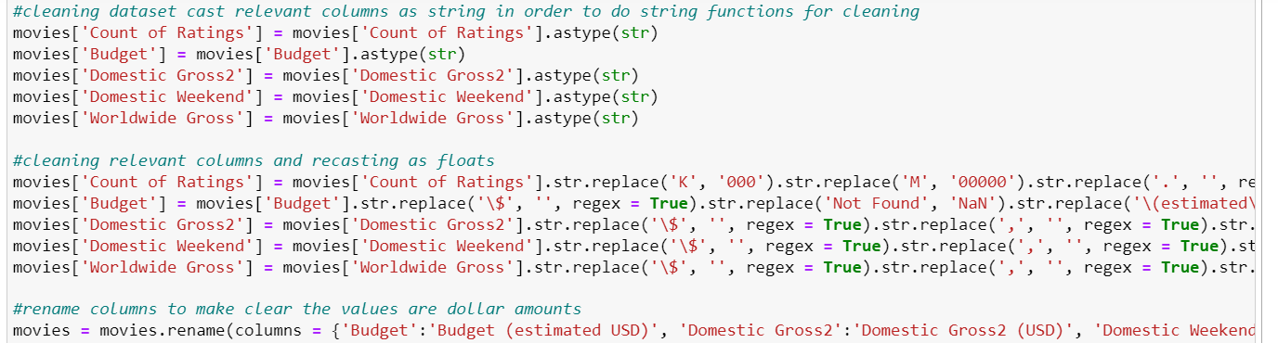
1.2 Data Setup and Cleaning
When beginning to conduct analysis on the dataset, several steps were taken to make it more workable.
First, additional columns were placed into the dataset denoting each movie’s genre and the season during which the movie was released. This provided additional input factors and allowed for some further analysis.
Then multiple string functions were conducted to clean the dataset. The Count of Ratings, Budget, Domestic Gross2, Domestic Weekend, and Worldwide Gross columns were all cleaned with the use of regex and recast as floats as well as renamed to be able to conduct statistical analysis on the columns.
Several rows contained missing data for the Budget, Domestic Gross2, Domestic Weekend, and Worldwide Gross columns and needed to be dropped. The Budget and Worldwide Gross columns were the focus of statistical analysis and only rows with missing values for those columns were dropped from the dataset.

Slide 6
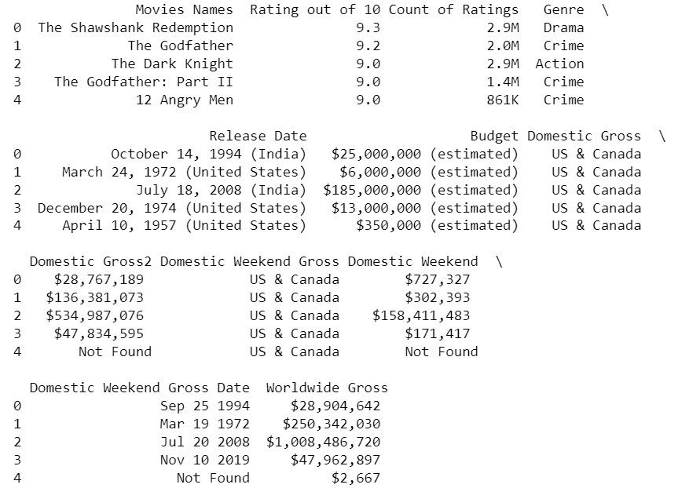
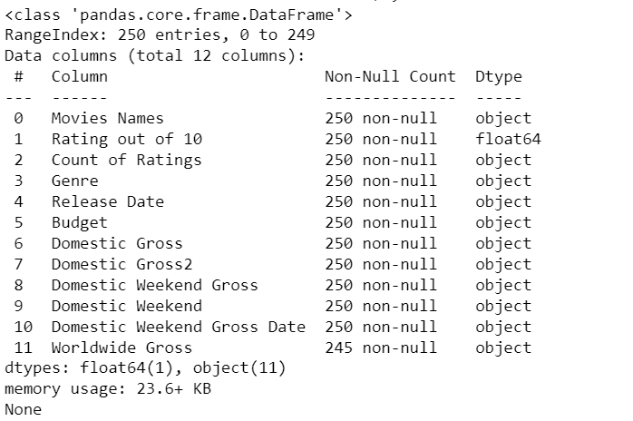
Initial Look at Dataset
Calling Initial Dataset
print(movies.head())
print(movies.info())

Slide 7
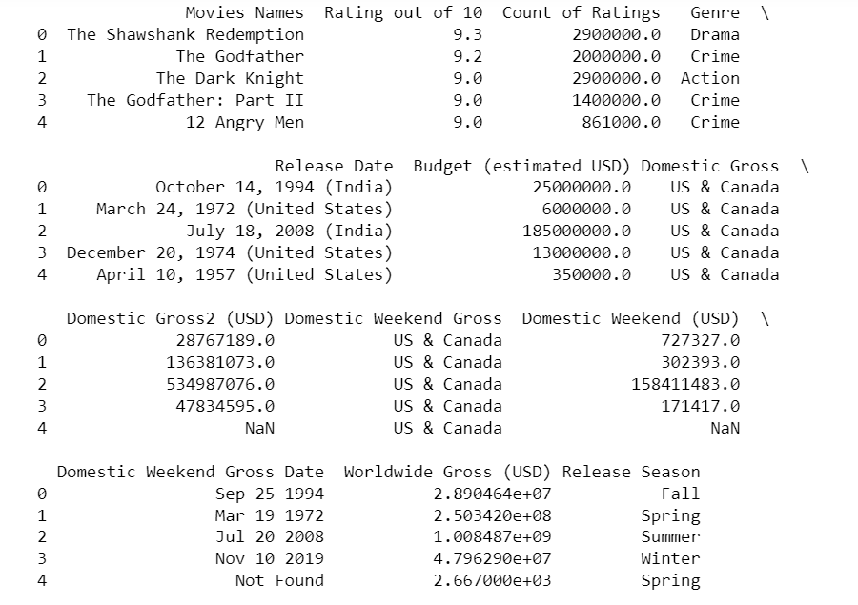
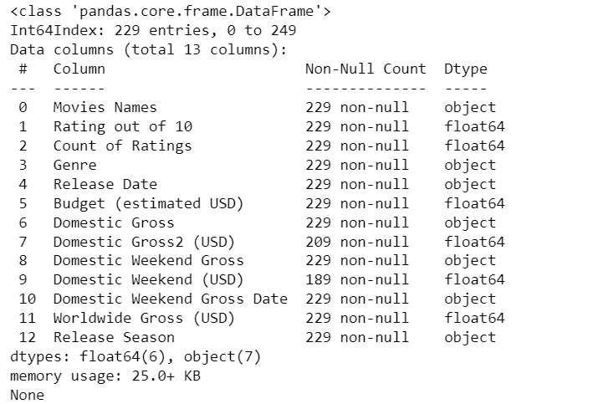
Looking at Cleaned Dataset
Calling Cleaned Dataset
print(movies.head())
print(movies.info())

Slide 8
Section 2: Analyzing Worldwide Earnings

Slide 9

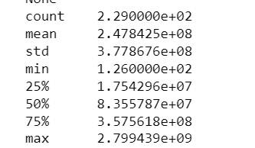
2.1 Initial Insights
First inspections of summary statistics for the Worldwide Gross column show a very wide range in earnings. The minimum value in the dataset is only $126, and the maximum value is ~$2.8 billion earned. The average earnings among the top 250 films is ~$250 million.
Upon inspection of the dataset, there are several rows with abnormally low values for worldwide earnings. Commonalities between these outliers are in the age of the film or where it was released, with all films in the dataset earning <$100000 being released before 1967, internationally, or both.
This insight indicates some type of shortcoming in the data collection for box office earnings, either through lack of resources or available information.
Worldwide Gross (USD)

Slide 10
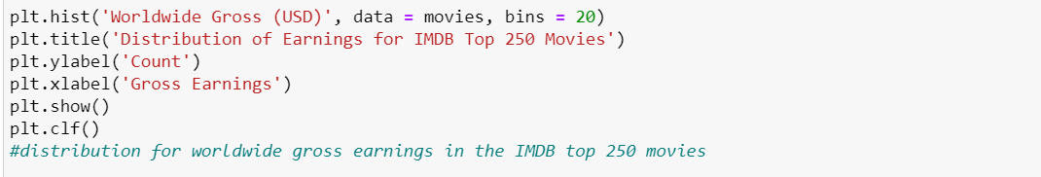
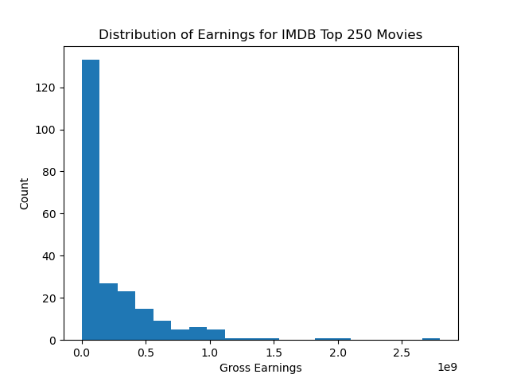
Initial Insights continued
When looking at the distribution for the earnings, it is highly right-skewed.
A large majority of the films (>140) earned less than $250 million, the average found earlier for the gross earnings column. A factor contributing to this is the abnormally low earnings values previously noted.

Slide 11
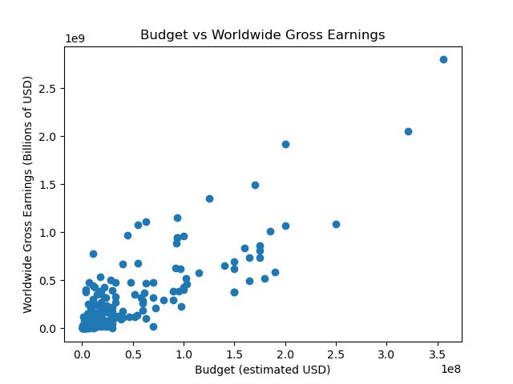
2.2 How Does Budget Affect Earnings?
The relationship between a film’s budget and worldwide earnings was analyzed through the creation of a scatter plot.
The scatter plot shows a positive relationship between the variables with points going from the bottom left to the top right of the graph.
Using PearsonR the correlation value is found to be 0.8367 indicating a high correlation between the two variables. Meaning a film that is given a larger budget is likely to earn more at the box office.

Slide 12
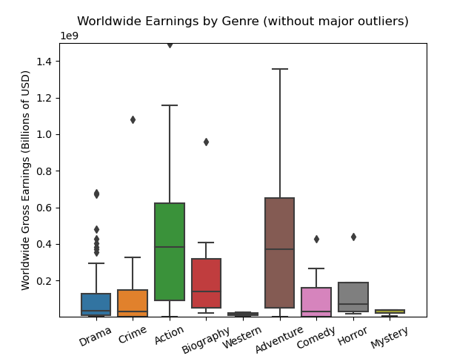
2.3 How Does Genre Affect Earnings?
To investigate the relationship between a movie’s genre and the worldwide gross box office earnings side-by-side boxplots were used.
The graph shows that action and adventure films outperform other genres, with plots that sit almost entirely above those of other genres. Biographical films also perform quite well sitting above most genres, but do not have as wide a range of earnings as action and adventure films.
Conversely western and mystery movies are the worst box office performers, with plots that sit almost entirely below those of other genres.

Slide 13
How does genre affect earnings continued
The drama, crime, comedy, and horror genres all perform similarly as indicated by the large amount of overlap in their plots.
They also exhibit a positive skew where their median value is below the average. This indicates there are outlier films in the genre pulling the average earnings up as a whole, meaning there is potential upside for exceptional box office performances.

Slide 14
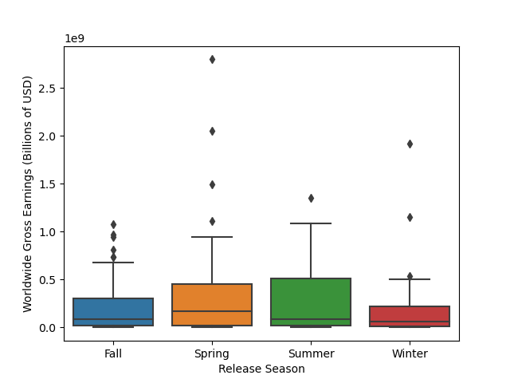
2.4 How Does Release Season Affect Earnings?
Looking into the relationship between a movie’s release date and earnings, side-by-side boxplots indicate that there is not much of an impact.
The plots for each season have considerable amounts of overlap. Movies released in the spring and summer have a wider range of earnings with a positive skew indicating there might be a few blockbuster films that perform exceptionally well pulling the average earnings up.

Slide 15
Section 3: Analyzing Ratings

Slide 16

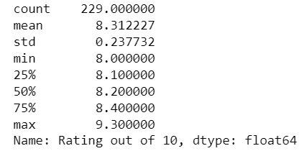
3.1 Initial Insights
First inspections of summary statistics for IMDB rating indicate that unsurprisingly all the movies tend to perform quite well with audiences.
All the movies are rated at or above 8.0, with the highest rated film receiving a 9.3 audience score.
The standard deviation indicates that most of the films (~68%) received a rating between 8.1 and 8.5
Rating out of 10

Slide 17
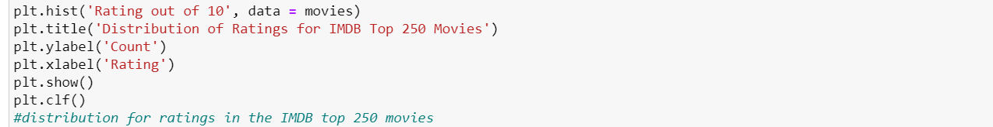
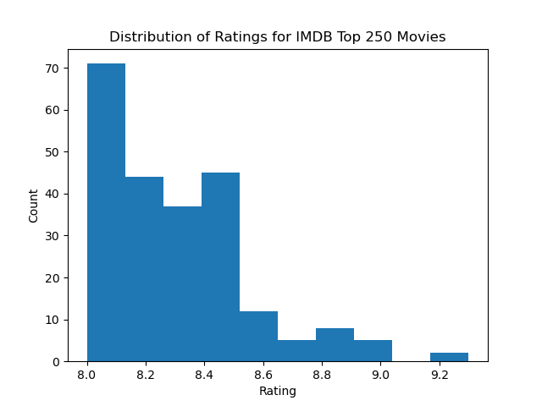
Initial insights continued
The distribution for IMDB ratings is more normally distributed than that of the earnings distribution, but there is still a slight right-skew in the data. Most films on the list earned an 8.0 or 8.1 rating, causing the skew.
The ratings are grouped together very closely, with less than 25% of the films receiving a rating over 8.6

Slide 18
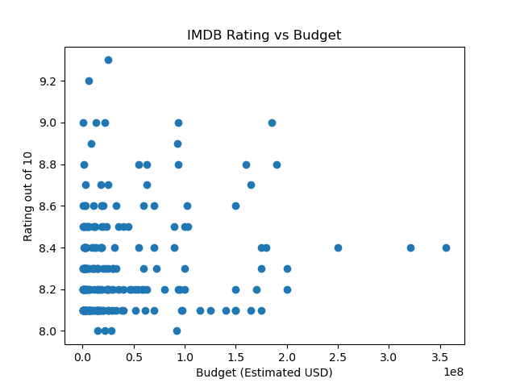
3.2 How Does Budget Affect Ratings?
The scatter plot shows that there is not much of a correlation between a movies budget and the rating it received.
A majority of the points are on the left side of the plot, regardless of the rating received. The highest budget films also received a rating of 8.4 which is just above the average for all films.
The PearsonR correlation value is 0.1327 indicating a weak correlation. The budget for a film seems to have little to no bearing on how audiences will receive it.

Slide 19
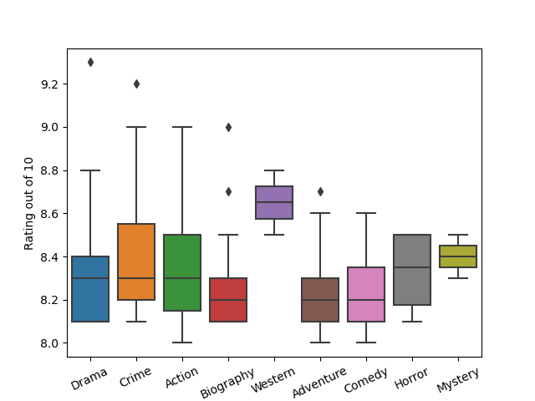
3.3 How Does Genre Affect Ratings?
Boxplots indicate that there is not much difference in ratings based on a movie’s genre.
Most plots have large amounts of overlap in the middle 50% of the plots.
The western genre sits comfortably above all other plots, indicating that audiences might receive western films better than other genres

Slide 20
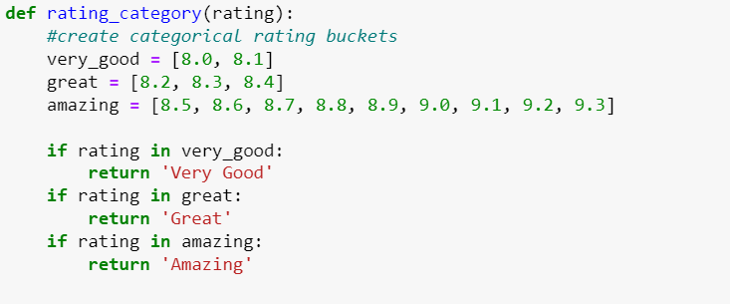
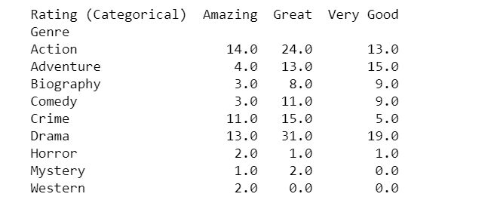
Diving deeper into the differences between a genre’s audience rating, movies were placed into categorical buckets. Very Good being the bottom 25% of ratings, Great being the middle 50%, and Amazing being the top 25% of ratings across all movies.
The crime, horror, western, and mystery genres have the highest percentage of movies that received an ‘Amazing’ rating (>30% for those genres)
Comedy and adventure films tend not to score very highly compared to other genres, with a high proportion of films scoring in the bottom 25% of ratings.

Slide 21
Section 4: Conclusions

Slide 22
4.1 Analysis Findings
A film’s budget is the biggest found indicator of box office success.
While action and adventure films earn the most out of all genres, there seems to be no strong link between a film’s genre and how well it will perform in the box office.
There are no strong indicators of how a film will perform with audiences based on genre or film budget.
Western films are received well by audiences in terms of film rating, but do not generate large amounts of revenue. Receiving the highest proportion of ‘Amazing’ ratings but the lowest range of earnings in the box office.

Slide 23
4.2 What Further Analysis Can be Conducted?
The analysis conducted was somewhat limited in its scope due to the nature of the available information in the dataset. Only a few variables were investigated to conduct analysis, and the variables only make up a small part of what goes into producing a film.
Questions to ask and investigate further would be:
Are there directors who consistently create better performing films, both in box office and audience rating?
Do audiences prefer movies with certain actors over others?
Is there a link between a movie’s age certification and its box office performance?

